Slide 1
CSE5012: Assignment 1
Adaptive Improved Fast Evolutionary Programming
Department of Computer Science and Engineering
Guotong Wu

Slide 2
1
Introduction
2
Algorithm Framework
Content
3
Experimental Results
4
Conclusion
5
Reference

Slide 3
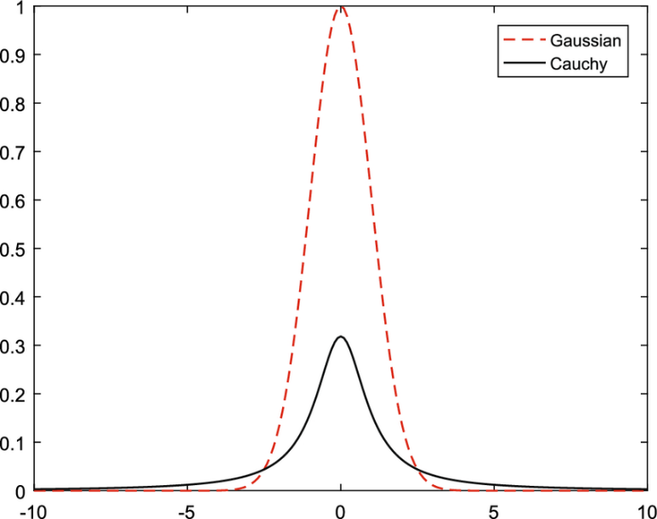


1
Introduction
Evolutionary Programming (EP) has a wide application on solving optimization problem.
The Classical Evolutionary Programming (CEP) uses the Gaussian Distribution to mutate offspring, while the Fast Evolutionary Programming (FEP) uses the Cauchy Distribution [1].
$$\begin{aligned}x_{i}^{′}\left(j\right)= x_{i}^{′}\left(j\right)+η_{i}× N_{j}\left(0,1\right)\#\end{aligned}$$
$$x_{i}^{′}\left(j\right)= x_{i}^{′}\left(j\right)+η_{i}×δ_{j}$$
The Gaussian distribution is more efficient when the optimal value is close, but the Cauchy distribution is opposite. Thus Improved Evolutionary Programming (IFEP) has been proposed to combine the two advantages.

Slide 4
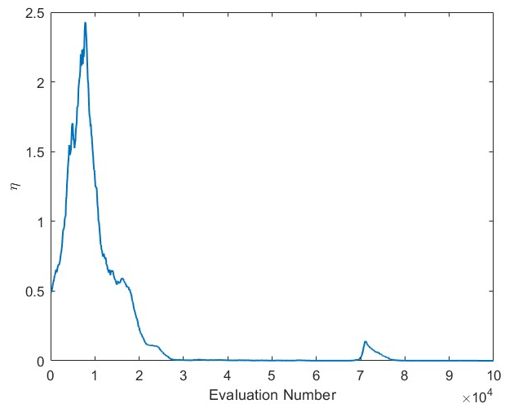
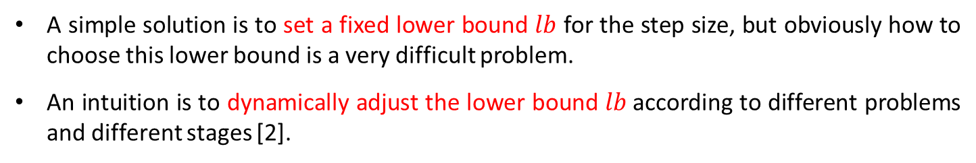
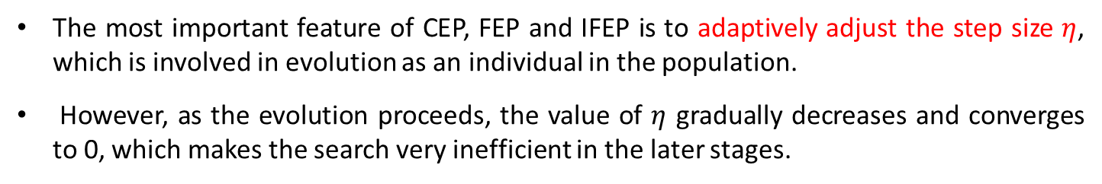
1
Introduction
The most important feature of CEP, FEP and IFEP is to adaptively adjust the step size $η$, which is involved in evolution as an individual in the population.
However, as the evolution proceeds, the value of $η$ gradually decreases and converges to 0, which makes the search very inefficient in the later stages.
A simple solution is to set a fixed lower bound $lb$ for the step size, but obviously how to choose this lower bound is a very difficult problem.
An intuition is to dynamically adjust the lower bound $lb$according to different problems and different stages [2].

Slide 5
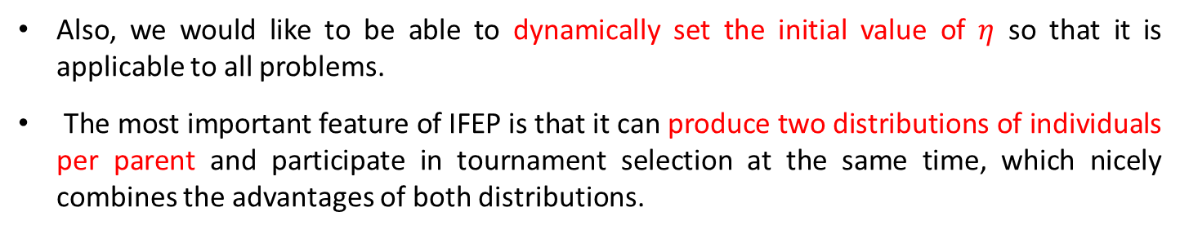
1
Introduction
Also, we would like to be able to dynamically set the initial value of $η$ so that it is applicable to all problems.
The most important feature of IFEP is that it can produce two distributions of individuals per parent and participate in tournament selection at the same time, which nicely combines the advantages of both distributions.
Tournament Selection
Parent
…
Offspring
However, we hope to find more excellent combination method.

Slide 6
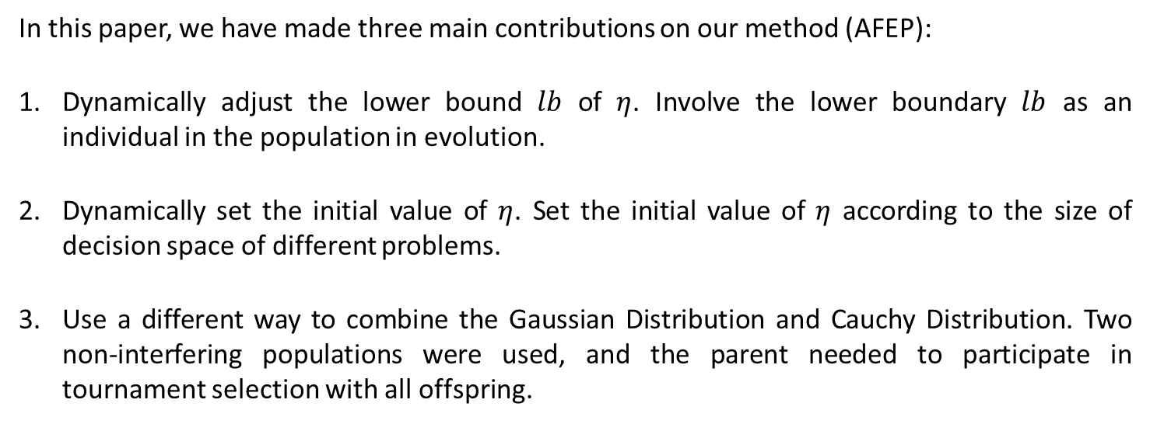
1
Introduction
In this paper, we have made three main contributions on our method (AFEP):
Dynamically adjust the lower bound $lb$ of $η$. Involve the lower boundary $lb$ as an individual in the population in evolution.
Dynamically set the initial value of $η$. Set the initial value of $η$ according to the size of decision space of different problems.
Use a different way to combine the Gaussian Distribution and Cauchy Distribution. Two non-interfering populations were used, and the parent needed to participate in tournament selection with all offspring.

Slide 7

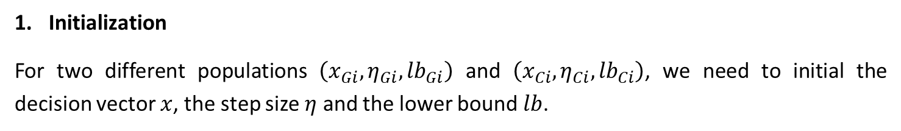

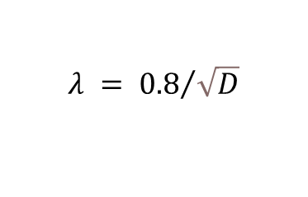
2
Algorithm Framework
Initialization
For two different populations $\left(x_{Gi},η_{Gi},{lb}_{Gi}\right)$ and $\left(x_{Ci},η_{Ci},{lb}_{Ci}\right)$, we need to initial the decision vector $x$, the step size $η$ and the lower bound $lb$.
$$η =λ× rand× \left(X_{max}\left(j\right)−X_{min}\left(j\right)\right)$$
$$λ = {0.8}/{\sqrt{D}}$$
$$lb =mean(η)$$
2. Mutation
For two different populations, they will produce new offspring according to their different operators.
$$x_{Gi}^{′}\left(j\right)= x_{Gi}^{′}\left(j\right)+η_{Gi}× N_{j}\left(0,1\right)$$
$$x_{Ci}^{′}\left(j\right)= x_{Ci}^{′}\left(j\right)+η_{Ci}×δ_{j}$$
For step size $η$ and lower bound $lb$:
$$η_{i}^{′}\left(j\right)=η_{i}\left(j\right)× exp\left(τ^{′}N\left(0,1\right)+τ N_{j}\left(0,1\right)\right)$$
$$lb^{′}\left(j\right)=lb\left(j\right)×\exp\left(N\left(0,1\right)\right)$$

Slide 8
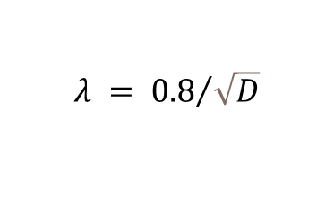

2
Algorithm Framework
3. Compute the fitness
Calculate the fitness of an individual by the fitness function.
$$η =λ× rand× \left(X_{max}\left(j\right)−X_{min}\left(j\right)\right)$$
$$λ = {0.8}/{\sqrt{D}}$$
$$lb =mean(η)$$
4. Selection
For two different populations, each parent will participate the tournament selection with all the offspring.
$$Pop1 = \left\{\left(x_{Gi},η_{Gi}\right),\left(x_{Gi}^{′},η_{Gi}^{′}\right),\left(x_{Ci}^{′},η_{Ci}^{′}\right)\right\}$$
$$Pop2 = \left\{\left(x_{Ci},η_{Ci}\right),\left(x_{Gi}^{′},η_{Gi}^{′}\right),\left(x_{Ci}^{′},η_{Ci}^{′}\right)\right\}$$
5. Repeat
Repeat to the mutation step until the evaluation number is enough.

Slide 9
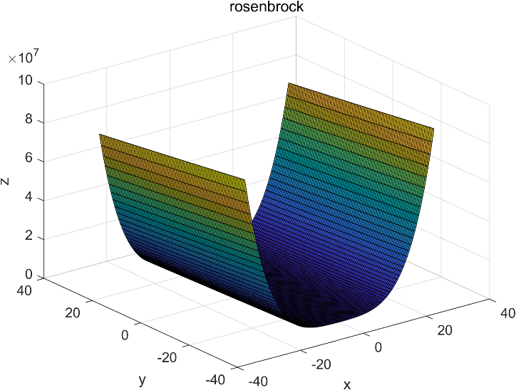
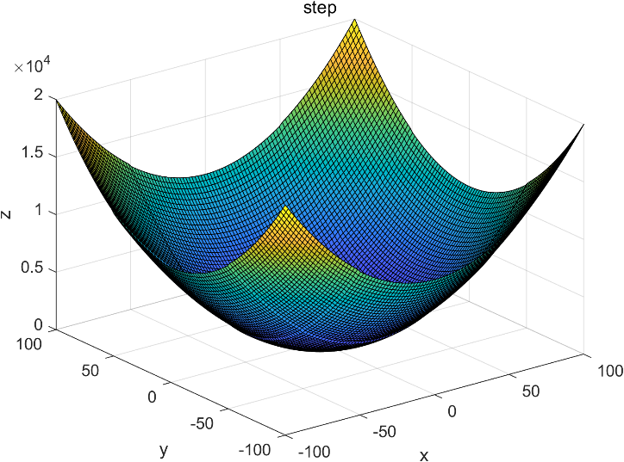

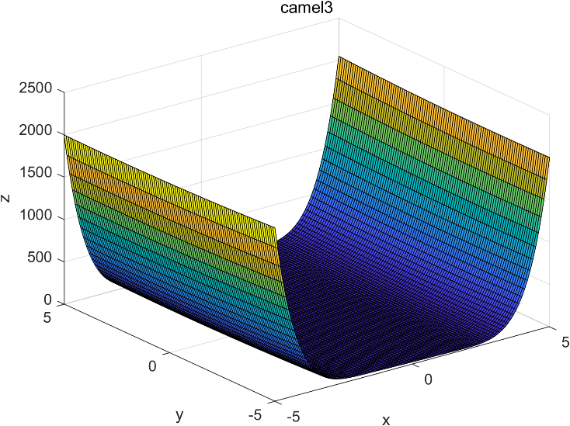
3
Experimental Results
To understand the characteristics of the test function, we plot its objective surface in a three-dimensional decision space

Slide 10
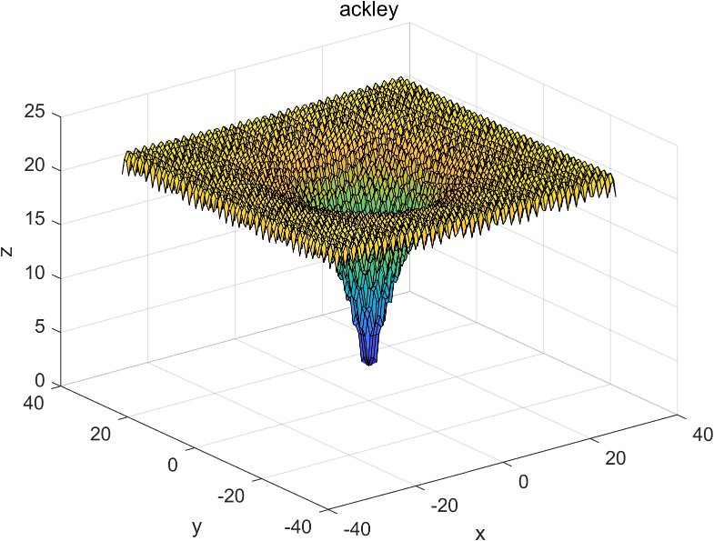
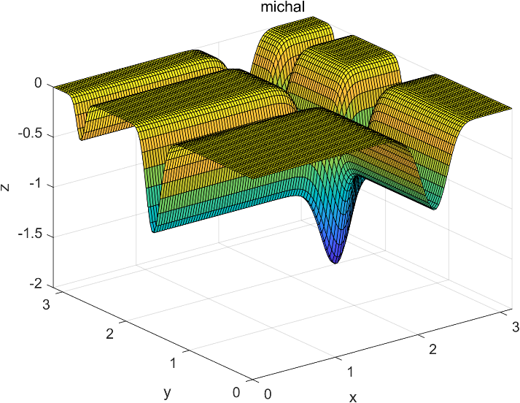
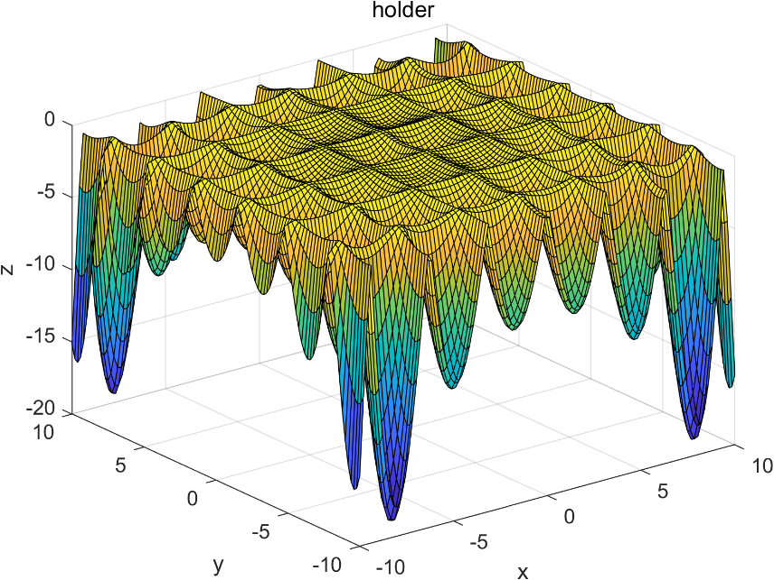
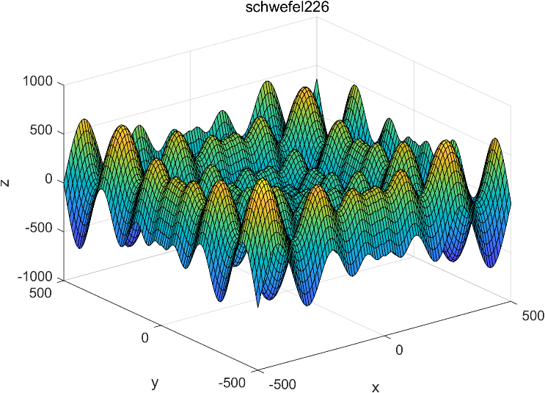
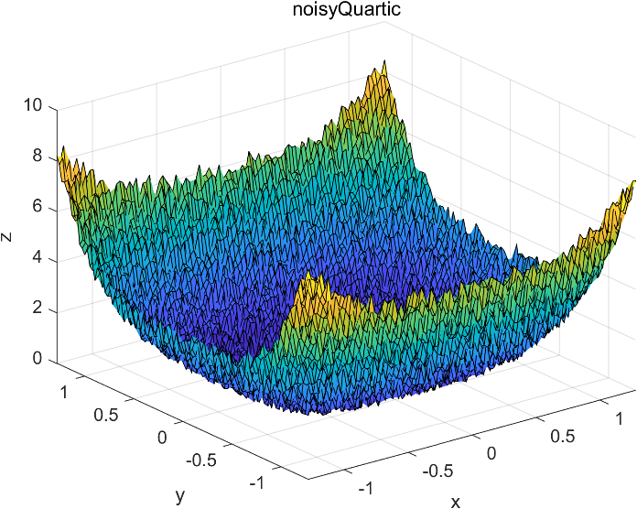
3
Experimental Results
To understand the characteristics of the test function, we first plot its objective surface in a three-dimensional decision space

Slide 11
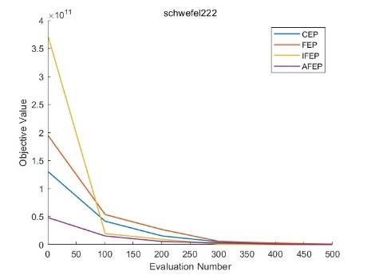
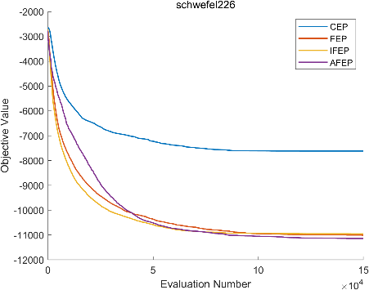
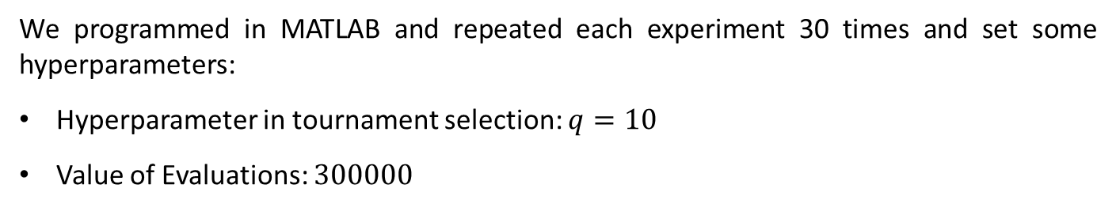
3
Experimental Results
We programmed in MATLAB and repeated each experiment 30 times and set some hyperparameters:
Hyperparameter in tournament selection: $q=10$
Value of Evaluations: $300000$
Then the performance of CEP, FEP, IFEP and AFEP is compared.

Slide 12
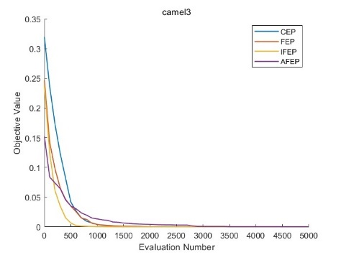
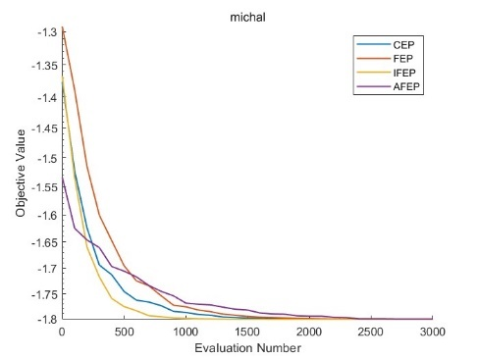
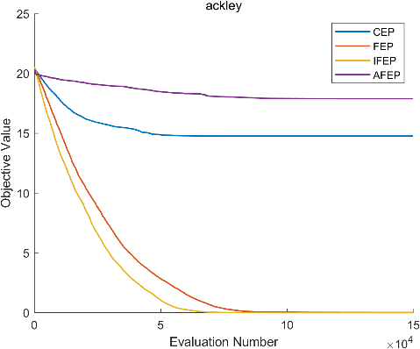
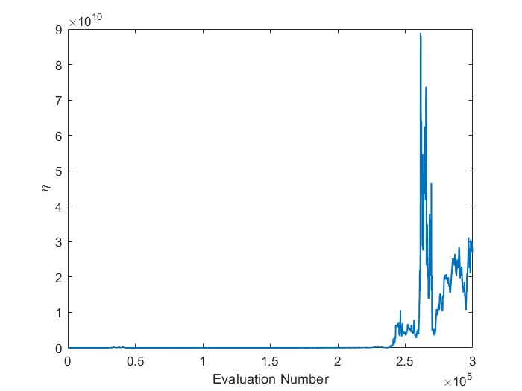
3
Experimental Results
On some problems, FEP can obtain better performance although the convergency is slower than FEP.
However, sometimes the performance of AFEP can be very poor, and we evaluate the change of step size $η.$

Slide 13
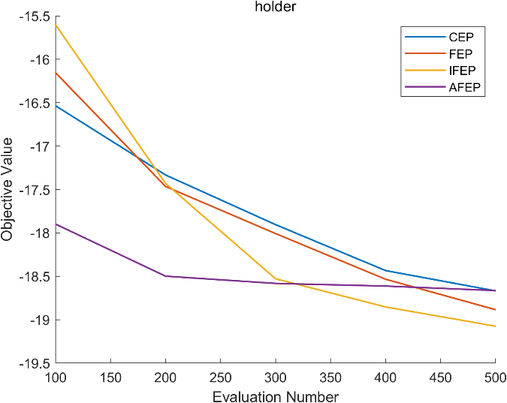
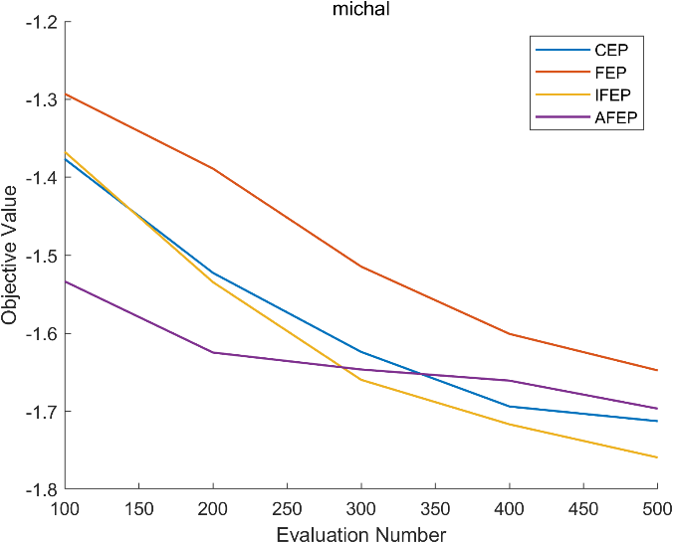
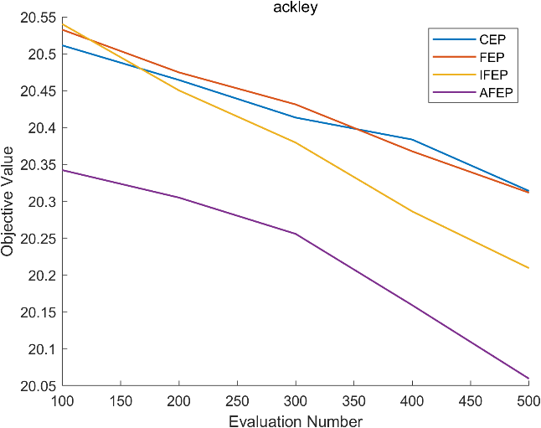
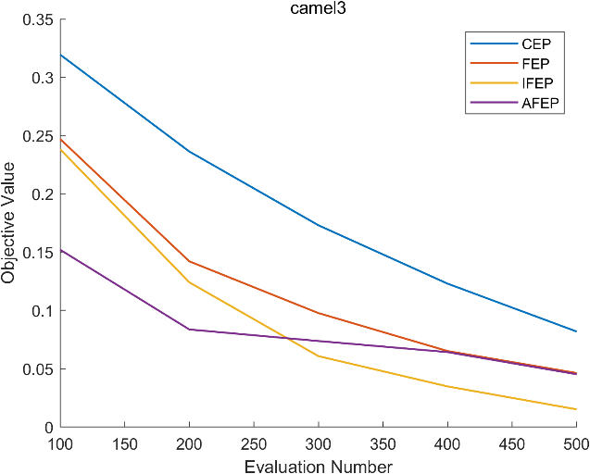
3
Experimental Results
And we also verify whether the initialization strategy of step size $η$ has an impact on the pre-evolutionary process

Slide 14
3
Experimental Results
Finally, we used Wilcoxon Signed Ranks Test to compare the performance of AFEP with CEP, FEP, IFEP
Problem | N | M | D | FE | CEP | IFEP | FEP | AFEP
rosenbrock | 100 | 1 | 30 | 300000 | 6.8326e+1 (5.67e+1) = | 5.8048e+1 (4.08e+1) = | 4.2198e+1 (3.22e+1) = | 6.0249e+1 (5.10e+1)
camel3 | 100 | 1 | 2 | 300000 | 1.7896e-11 (2.23e-11) - | 1.9559e-11 (2.29e-11) - | 2.4920e-11 (2.35e-11) - | 0.0000e+0 (0.00e+0)
holder | 100 | 1 | 2 | 300000 | -1.9209e+1 (2.20e-10) - | -1.9209e+1 (1.67e-10) - | -1.9209e+1 (2.06e-10) - | -1.8709e+1 (7.14e-15)
schwefel222 | 100 | 1 | 30 | 300000 | -2.0268e+2 (2.02e+1) - | -2.2579e+2 (3.73e+0) - | -2.2700e+2 (2.90e+0) - | -2.4779e+2 (1.02e+1)
schwefel226 | 100 | 1 | 30 | 300000 | -7.6633e+3 (6.88e+2) - | -1.0983e+4 (3.26e+2) = | -1.1060e+4 (3.59e+2) = | -1.1122e+4 (4.55e+2)
ackley | 100 | 1 | 30 | 300000 | 1.6226e+1 (2.45e+0) + | 4.2151e-3 (2.54e-4) + | 1.0761e-2 (1.06e-3) + | 1.7860e+1 (6.06e+0)
michal | 100 | 1 | 2 | 300000 | -1.8013e+0 (2.83e-10) - | -1.8013e+0 (6.27e-10) - | -1.8013e+0 (8.63e-10) - | -1.8013e+0 (9.03e-16)
noisyQuartic | 100 | 1 | 30 | 300000 | 8.5895e-4 (6.65e-4) + | 1.1592e-3 (1.00e-3) = | 2.5278e-3 (1.18e-3) + | 2.5293e-3 (5.63e-3)
sphere | 100 | 1 | 30 | 300000 | 2.5122e-5 (3.49e-6) + | 3.3717e-5 (4.24e-6) + | 2.2185e-4 (3.81e-5) + | 3.7390e-1 (1.79e+0)
step | 100 | 1 | 30 | 300000 | 5.4515e+3 (4.77e+3) - | 8.3333e-1 (1.15e+0) = | 0.0000e+0 (0.00e+0) + | 1.0433e+1 (4.96e+1)
+/-/= |  |  |  |  | 3/6/1 | 2/4/4 | 4/4/2

Slide 15
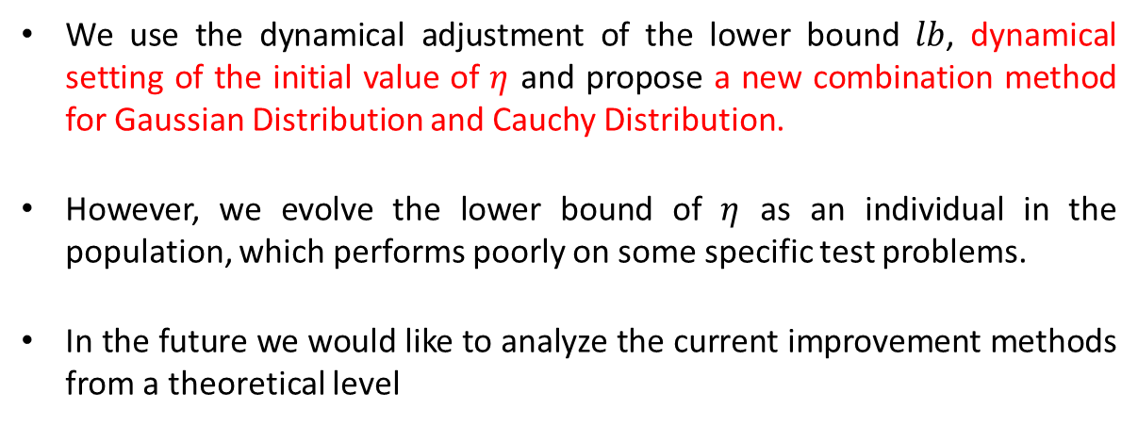
4
Conclusion
We use the dynamical adjustment of the lower bound $lb$, dynamical setting of the initial value of $η$ and propose a new combination method for Gaussian Distribution and Cauchy Distribution.
However, we evolve the lower bound of $η$ as an individual in the population, which performs poorly on some specific test problems.
In the future we would like to analyze the current improvement methods from a theoretical level

Slide 16
5
Reference
[1] Xin Yao, Yong Liu and Guangming Lin, "Evolutionary programming made faster," in IEEE Transactions on Evolutionary Computation, vol. 3, no. 2, pp. 82-102, July 1999, doi: 10.1109/4235.771163.
[2] Liang, Ko-Hsin, Xin Yao, and Charles S. Newton. "Adapting self-adaptive parameters in evolutionary algorithms." Applied Intelligence 15 (2001): 171-180.
[3] Mallipeddi, Rammohan, S. Mallipeddi, and Ponnuthurai N. Suganthan. "Ensemble strategies with adaptive evolutionary programming." Information Sciences 180.9 (2010): 1571-1581.

Slide 17
Thank you!

